Slide 1

DRUG REVIEWS

Slide 2


GROUP 4
Pavithran T.
Sakthi Jaisankar
Sanapala Manikanta
Soham Almalekar
Agath Clafio
Nicchanametla Bindu

Slide 3
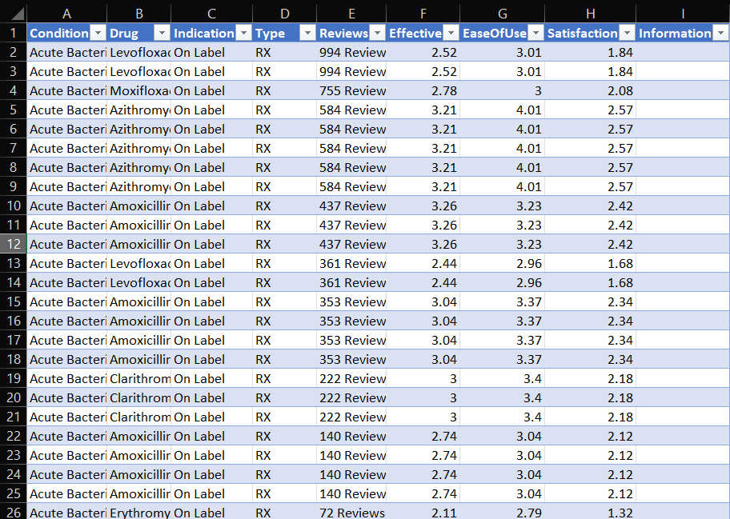
Understanding the Data

Slide 4
STEPS TO PERFORM
EDA : Exploratory Data Analysis
EDA is Exploratory Data Analysis, refers to the method of studying and exploring record sets to apprehend their predominant traits, discover patterns, locate outliers, and identify relationships between variables. EDA is normally carried out as a preliminary step before undertaking extra formal statistical analyses or modeling.
It involves Understanding of data , data cleaning, Handling missing data , Finding Outliers , Data Transformation , Feature Engineering , Data Visualization.

Slide 5
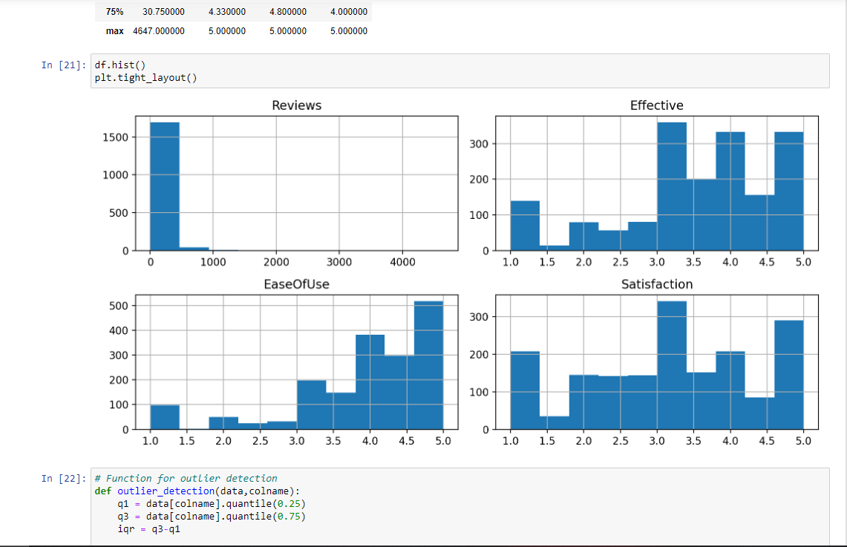
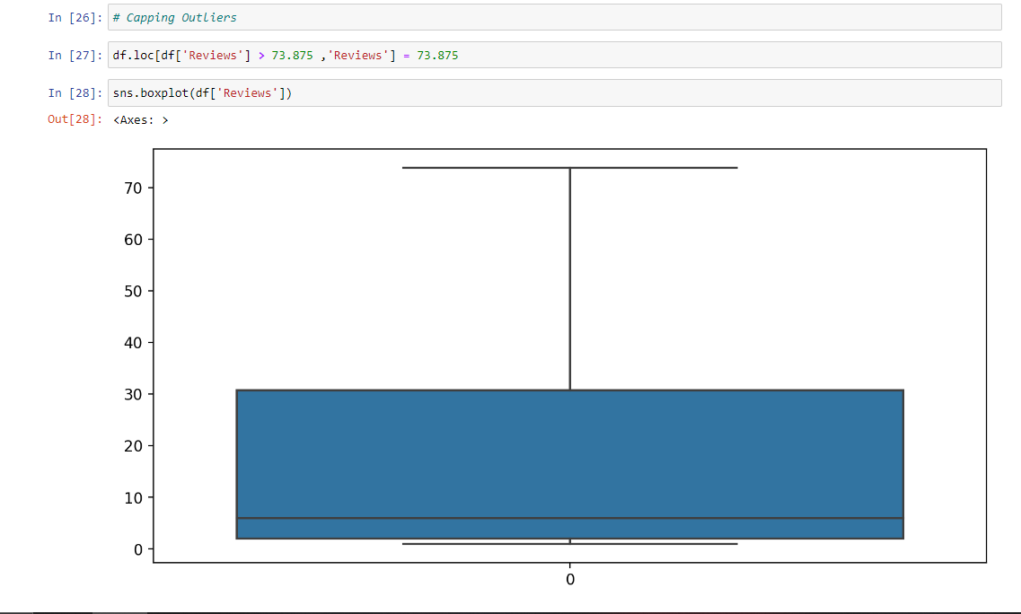
EXPLORATORY DATA ANALYSIS

Slide 6
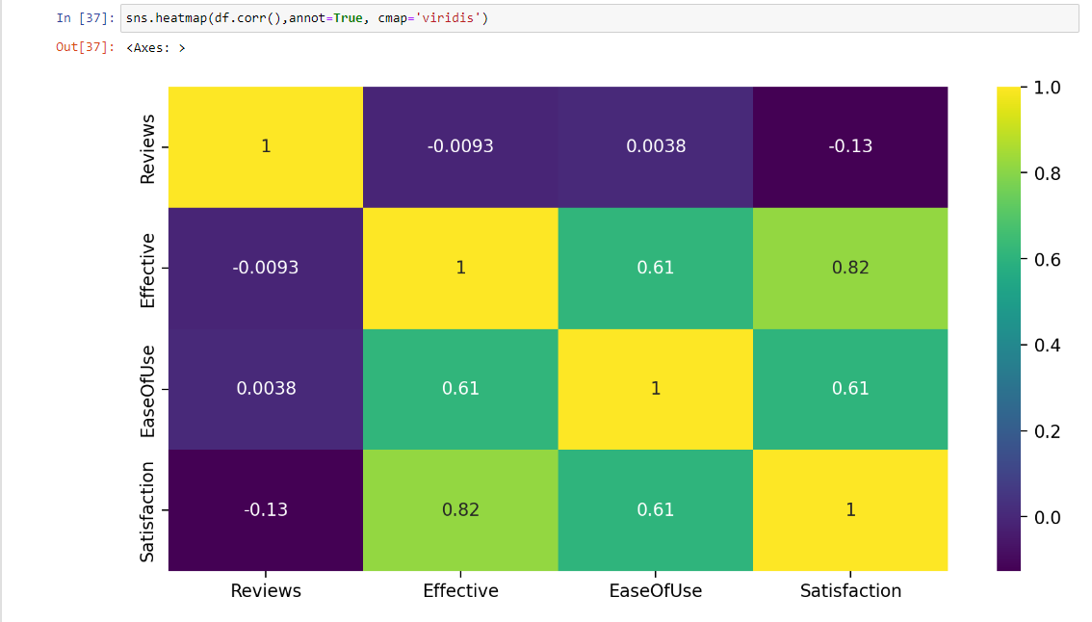

Slide 7
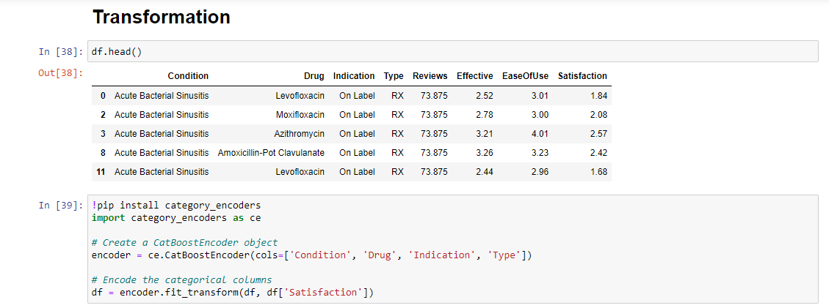

Slide 8
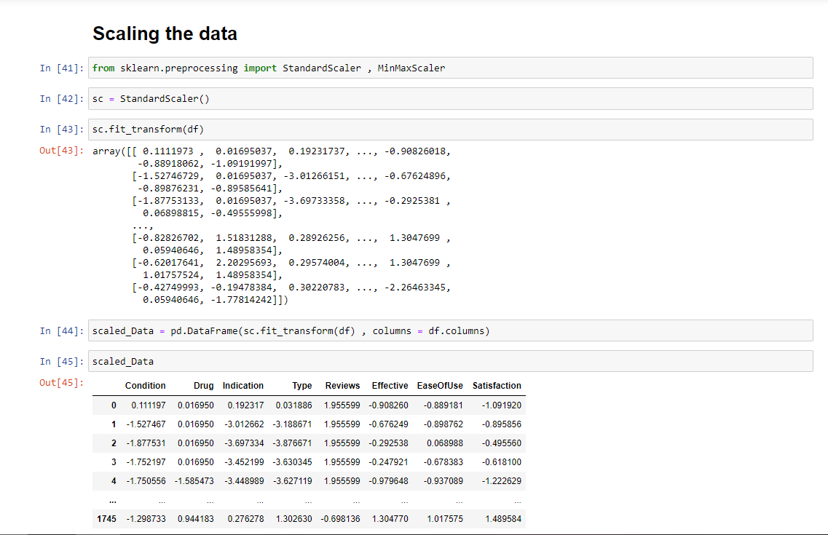

Slide 9
BUILDING MODELS
In machine learning, a model is a representation of a real-world process, system, or problem that we are trying to understand, analyze, or solve. A model is created using algorithms and trained on data, allowing it to make predictions or decisions without being explicitly programmed. There are various types of models in machine learning,
Models
Linear Regression
Lasso Regression
Ridge Regression
Decision Tree Regression
Random Forest
Support Vector Machine Regression
KNN Regression

Slide 10
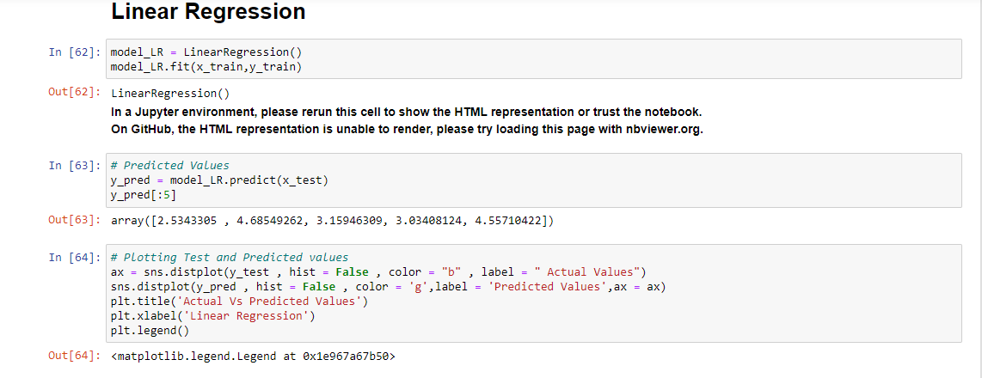

Slide 11
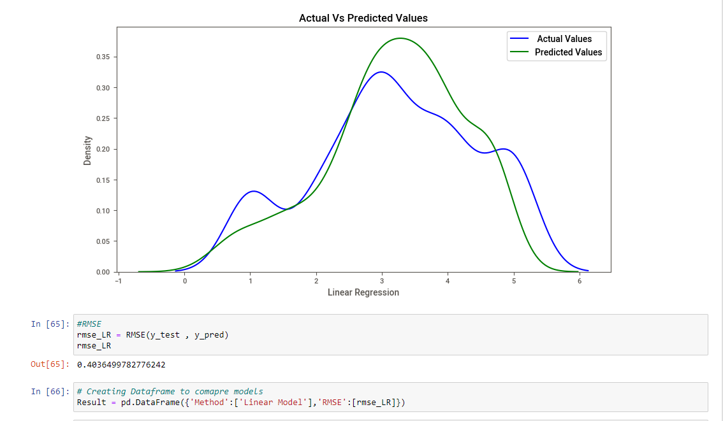

Slide 12
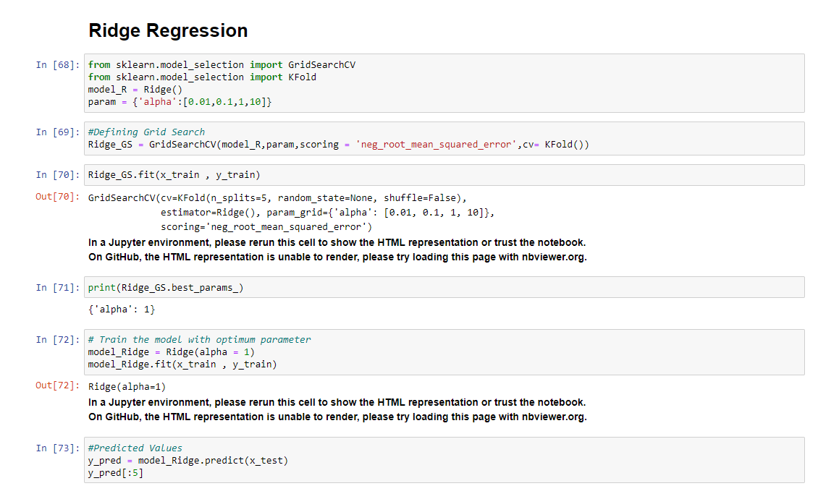

Slide 13
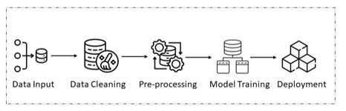
PIPELINE CREATION
In machine learning, a pipeline is a way to streamline a lot of the routine processes, making it easier to combine different steps and models together. A pipeline is a set of data processing elements connected in series, where the output of one element is the input of the next. It allows you to automate a machine learning workflow, making the code more modular, reproducible, and easier to understand.
A typical machine learning pipeline involves several steps, such as data preprocessing, feature engineering, model training, and evaluation.

Slide 14
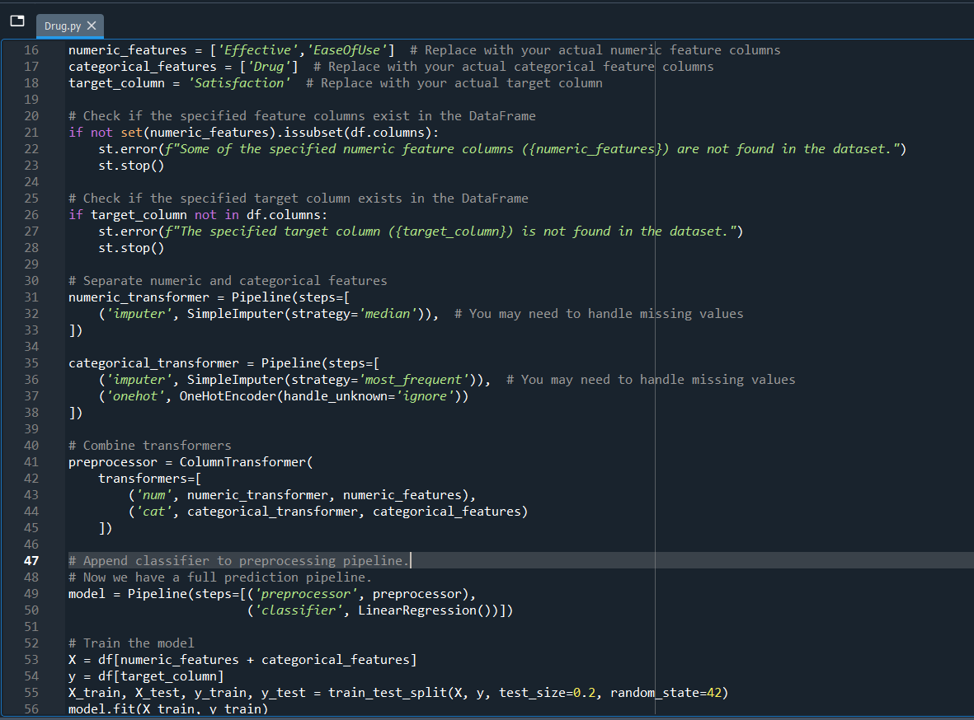

Slide 15
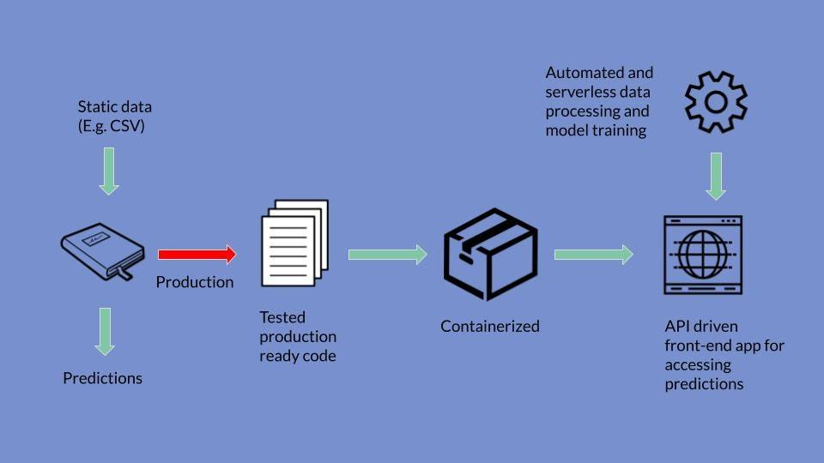
DEPLOYMENT
Deploying a machine learning model involves making the trained model available for use in real-world applications to make predictions on new, unseen data. Model deployment is a critical step that bridges the gap between the development of a machine learning model and its practical utilization.
Deploy the model as a web service or API (Application Programming Interface) that can be accessed by other applications. This allows for seamless integration with web or mobile applications, as well as other services.

Slide 16
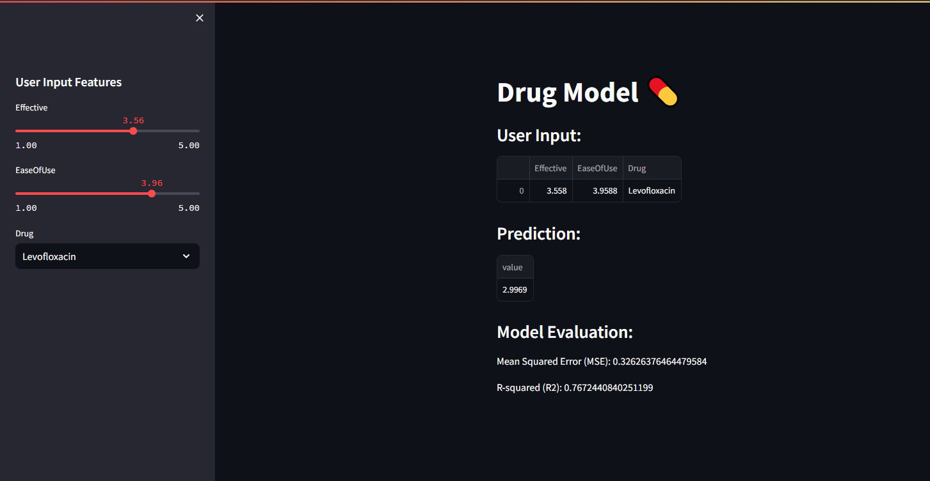

Slide 17

THANK YOU

